Slide 1
Edge Microgateway
Overview

Slide 2
Agenda
Edge Microgateway Overview
Use Cases for Microgateway
Digital Value Chain
Deployment Architecture

Slide 3
What is Edge Microgateway?
Microgateway is a Node.js application that can run anywhere Node.js can run provided that a public/private Edge installation is available.
It has a plugin architecture with default plugins for OAuth, quotas and spike arrest
Analytics are captured asynchronously and sent to Edge in batches
Starting with version 2.3.1, it always starts in cluster mode
Automatically reloads configuration changes made in Edge
Automatically reloads configuration changes made within its configuration YAML file
‹#›

Slide 4
Edge Microgateway
Create your own custom plugins in node.js and apply to both request and response flows. These will run directly on Edge Microgateway.
Custom Plugins
Spike arrest and quota policies are applied as defined on Edge.
Traffic Management
Security
OAuth 2 access token (JWT) and API Key verification is done in Edge Microgateway. API Key verification requires a connection to Edge.
Analytics
Analytics data sent to Edge asynchronously in batches. No impact on runtime traffic irrespective of Edge availability.
Operations
Use your own internal process and tools to deploy, manage and monitor Edge Microgateway.
‹#›
Notes:
Quota policy using the local cache configuration (downloaded from Edge during the configuration step).

Slide 5
Edge Microgateway
Unlike a full deployment of Apigee Edge, you can deploy and run an instance of Edge Microgateway within a matter of minutes.
Rapid Deployment
You can install and manage Edge Microgateway in the same machine, subnet, or data center as the backend target APIs.
Network Proximity
Reduced Latency
All communication with Apigee Edge is asynchronous and does not happen as part of processing client API requests.
Familiarity
Edge Microgateway uses and interacts with Apigee Edge features that Edge administrators already understand well.
Configuration
No programming is required to set up and execute Edge Microgateway out-of-the-box; everything is handled through configuration.
‹#›
Notes:
Reduced Latency: This allows Edge Microgateway to collect API data and send it to Apigee Edge without affecting latency.
Familiarity: features such as proxies, products, and developer apps.

Slide 6
Edge Microgateway
You can integrate Edge Microgateway with your existing application monitoring and management infrastructure and processes.
Convenience
It's simple to install, configure, and maintain.
Simple
Log files detail all the normal and exceptional events encountered during API processing by Edge Microgateway.
Logging
A command-line interface lets you start, stop, and restart Edge Microgateway, extract operating statistics, view log files, request access tokens, and more.
CLI
‹#›

Slide 7
Intelligent API platform enables the digital value chain
User
Connected Experience
Developer
API
API Team
Backend
Intelligent API Platform
Intelligent API Platform
INTELLIGENT API PLATFORM
‹#›

Slide 8
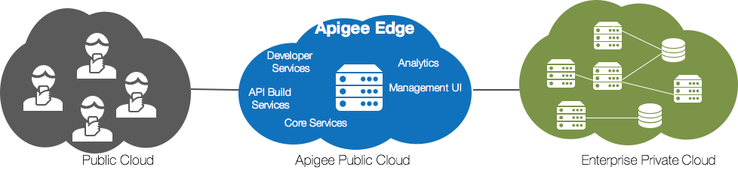
External & Partner APIs
‹#›

Slide 9
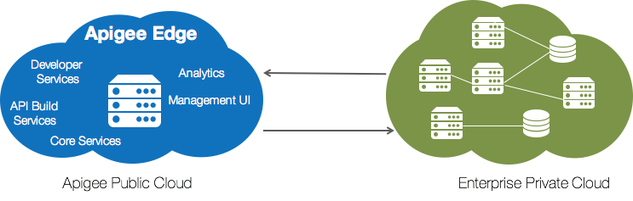
Internal APIs
‹#›

Slide 10
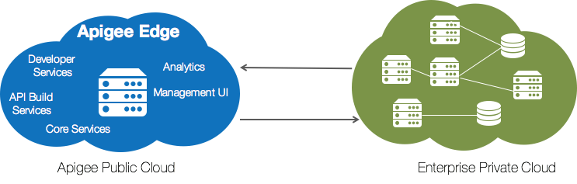
Internal APIs
What about latency and security?
‹#›

Slide 11
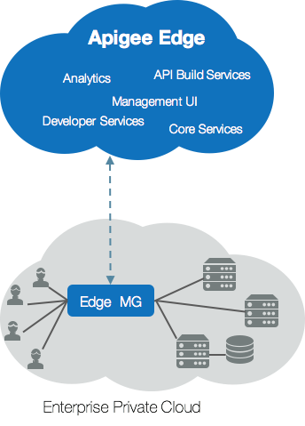

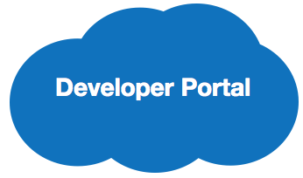

Edge Microgateway
Objective
Deploy lean API runtime infrastructure in your private cloud, while deriving all the benefits of Apigee API management in the Cloud
Use Cases
Reduce latency of API traffic that is completely internal to the enterprise
Keep API traffic within the enterprise approved boundaries for security or compliance purposes
Treat internal API consumers differently from external usage
‹#›

Slide 12
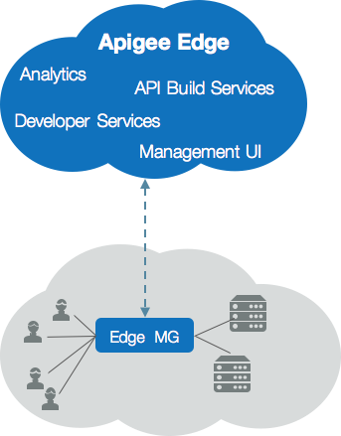
Edge Microgateway Deployment
1
Define your Microgateway (MG) aware proxies in Edge Cloud
Analytics data is pushed to the Apigee Cloud in batches
5
Edge MG downloads list of proxies and configurations on startup and at regular intervals
3
2
Configure your Edge MG to communicate with Edge Cloud
4
All runtime traffic hits the Edge MG - authentication, traffic management and plugin enforcement
‹#›
Notes:
* on item one denotes the fact that you cannot include any policies within the edgemicro_ aware proxy in Edge. You cannot include any conditional flows. Any custom configuration that you want to add to the Microgateway must be completed within a custom plugin module.

Slide 13

Edge Microgateway Deployment Architecture
Internet or Intranet
Internet
Microgateway
Client
Target API
Edge
Machine
i.e. Edge Microgateway deployed in Cloud Foundry; EM running on same container as target application.
‹#›
Notes:
http://docs.apigee.com/microgateway/v21x/edge-microgateway-overview-v21x
This diagram can represent a container or a VM.

Slide 14
Edge Microgateway Deployment Architecture
Machine
Internet or Intranet
Microgateway
Internet
Client
Edge
Load Balancer
Target API
Machine
‹#›
Notes:
http://docs.apigee.com/microgateway/v21x/edge-microgateway-overview-v21x
In this diagram we assume that there is only one target service running on a single machine. (i.e. no load balancer)

Slide 15
Edge Microgateway Deployment Architecture
Machine
Internet or Intranet
Internet
Microgateway
Proxy
Proxy
Client
Edge
Load Balancer
Load Balancer
Target API
Target API
Machine
Machine
‹#›
Notes:
http://docs.apigee.com/microgateway/v21x/edge-microgateway-overview-v21x
In this diagram we assume the following:
The target service running on both machines is the same
EM proxy is pointing to a load balancer which distributes request among the target servers
EM is not a load balancer!

Slide 16
Edge Microgateway Deployment Architecture
Client
Load-balancing and SSL termination
Internet or Intranet
Nginx
Edge
Internet
Microgateway
Microgateway
Machine
Load Balancer
Load Balancer
Target API
Target API
Machine
Machine
‹#›
Notes:
http://docs.apigee.com/microgateway/v21x/edge-microgateway-overview-v21x
In this diagram we assume the following:
The target service running on both machines is the same
EM proxy is pointing to a load balancer which distributes request among the target servers

Slide 17
Edge Microgateway Deployment Architecture
Intranet traffic protection
Internet
/orders
Edge
Internet
Intranet
http://mycompany.com/orders
API Implementation
Microgateway
API Implementation
/transactions
/customers
Machine
Machine
Notes:
The following text is from here http://docs.apigee.com/microgateway/v21x/edge-microgateway-overview-v21x#aboutedgemicrogateway-sampledeploymentscenarios
Use Edge Microgateway to protect intranet traffic while protecting internet traffic with Apigee Edge, as illustrated in Figure 5. Let's say an API endpoint /orders is proxied through Apigee Edge Cloud, and it hits the backend target https://mycompany.com/orders. This is represented by the target API implementation on the left. This API may then call multiple API endpoints represented by the target implementation on the right. For example, it may call internally /customers and /transactions. See also this post on the Apigee Community.

Slide 18
THANK YOU

